Slide 1
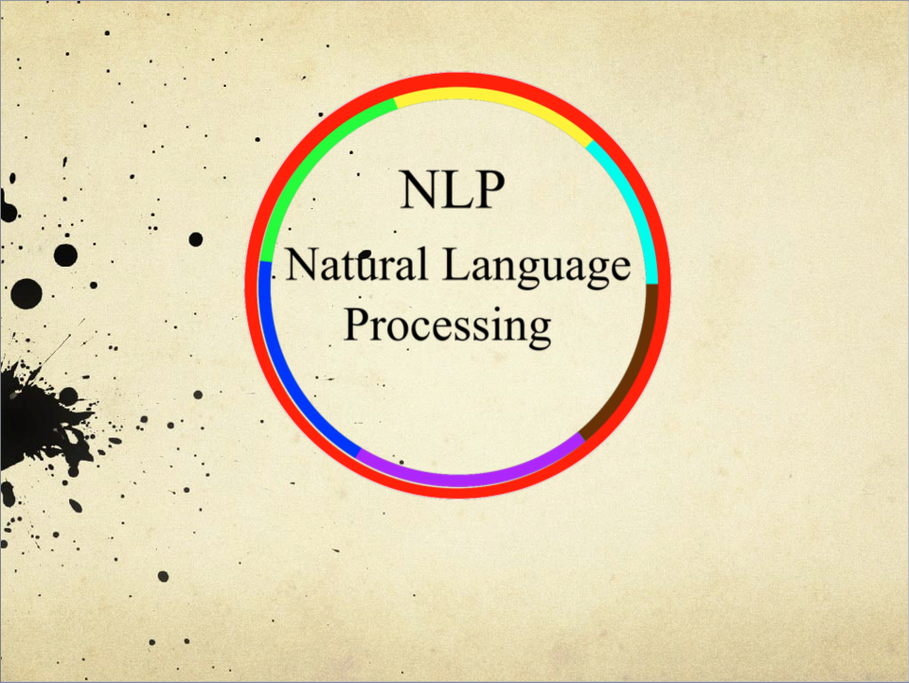

Slide 2
Applications
Spell Check/Autocorrect
Minimum Edit Distance
Spam Detection/Calendar Dates
Detection of keywords (Entity Extraction)
Consumer sentiment measurement
Finance, movie reviews, or any subject that can be written about (blogs, news articles, tweets, etc.)
Translations
Books, translator engines

Slide 3
Why NLP Can Be Hard
“Local High School Dropouts Cut in Half”

Slide 4
Why NLP Can Be Hard
“Local High School Dropouts Cut in Half”
i luv @beiber

Slide 5
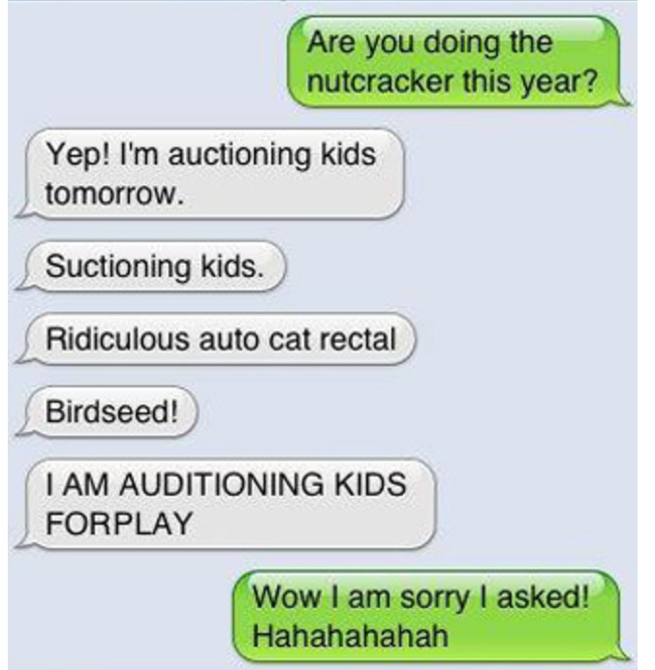
Why NLP Can Be Hard
“Local High School Dropouts Cut in Half”
i luv @beiber
Notes:
http://distractify.com/jake-heppner/funniest-auto-correct-fails/

Slide 6
Topics
Quick Terminology
Text Extraction/Stemming
Bag-of-words Model
Text Valuation/Text Representation
Similarity
Text Classification
Other Models: Probabilistic Models
Named Entity Recognition
Fundamental/
Basic Topics

Slide 7

Quick Terminology
There was no possibility of taking a walk that day
Notes:
https://d2gg9evh47fn9z.cloudfront.net/thumb_COLOURBOX6201203.jpg

Slide 8
Quick Terminology
There was no possibility of taking a walk that day
Document
Notes:
https://d2gg9evh47fn9z.cloudfront.net/thumb_COLOURBOX6201203.jpg

Slide 9
Quick Terminology
Words/Terms/Tokens
There was no possibility of taking a walk that day
Document
Notes:
https://d2gg9evh47fn9z.cloudfront.net/thumb_COLOURBOX6201203.jpg

Slide 10
Quick Terminology
There was no possibility of taking a walk that day
There was no possibility of taking a walk that day
There was no possibility of taking a walk that day
There was no possibility of taking a walk that day
There was no possibility of taking a walk that day
Corpus
Notes:
https://d2gg9evh47fn9z.cloudfront.net/thumb_COLOURBOX6201203.jpg

Slide 11
Quick Terminology
There was no possibility
There was no possibility
There was no possibility
There was no possibility
There was no possibility
There was no possibility
There was no possibility
There was no possibility
There was no possibility
There was no possibility
There was no possibility
There was no possibility
There was no possibility
There was no possibility
There was no possibility
There was no possibility
There was no possibility
There was no possibility
There was no possibility
There was no possibility
There was no possibility
There was no possibility
There was no possibility
There was no possibility
There was no possibility
There was no possibility
There was no possibility
There was no possibility
There was no possibility
There was no possibility
There was no possibility
There was no possibility
There was no possibility
There was no possibility
There was no possibility
There was no possibility
There was no possibility
There was no possibility
There was no possibility
There was no possibility
There was no possibility
There was no possibility
There was no possibility
Corpora
Notes:
https://d2gg9evh47fn9z.cloudfront.net/thumb_COLOURBOX6201203.jpg

Slide 12
Basic Text Processing (1)
Extraction/Regular Expressions

Slide 13
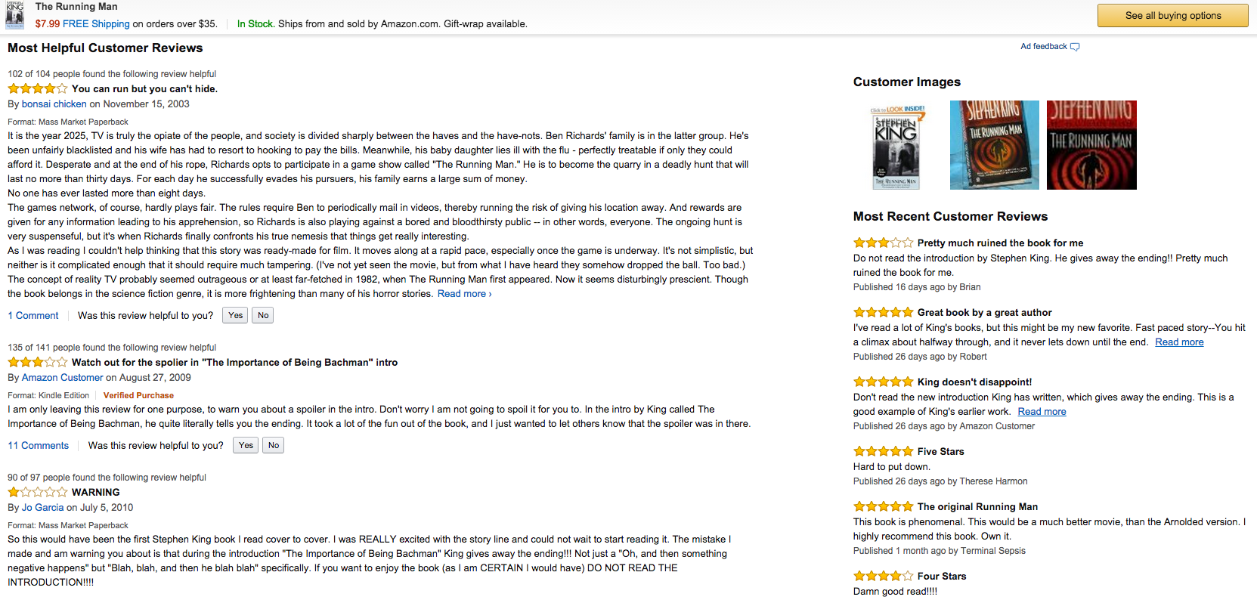
Notes:
http://www.amazon.com/The-Running-Man-Stephen-King/dp/0451197968

Slide 14
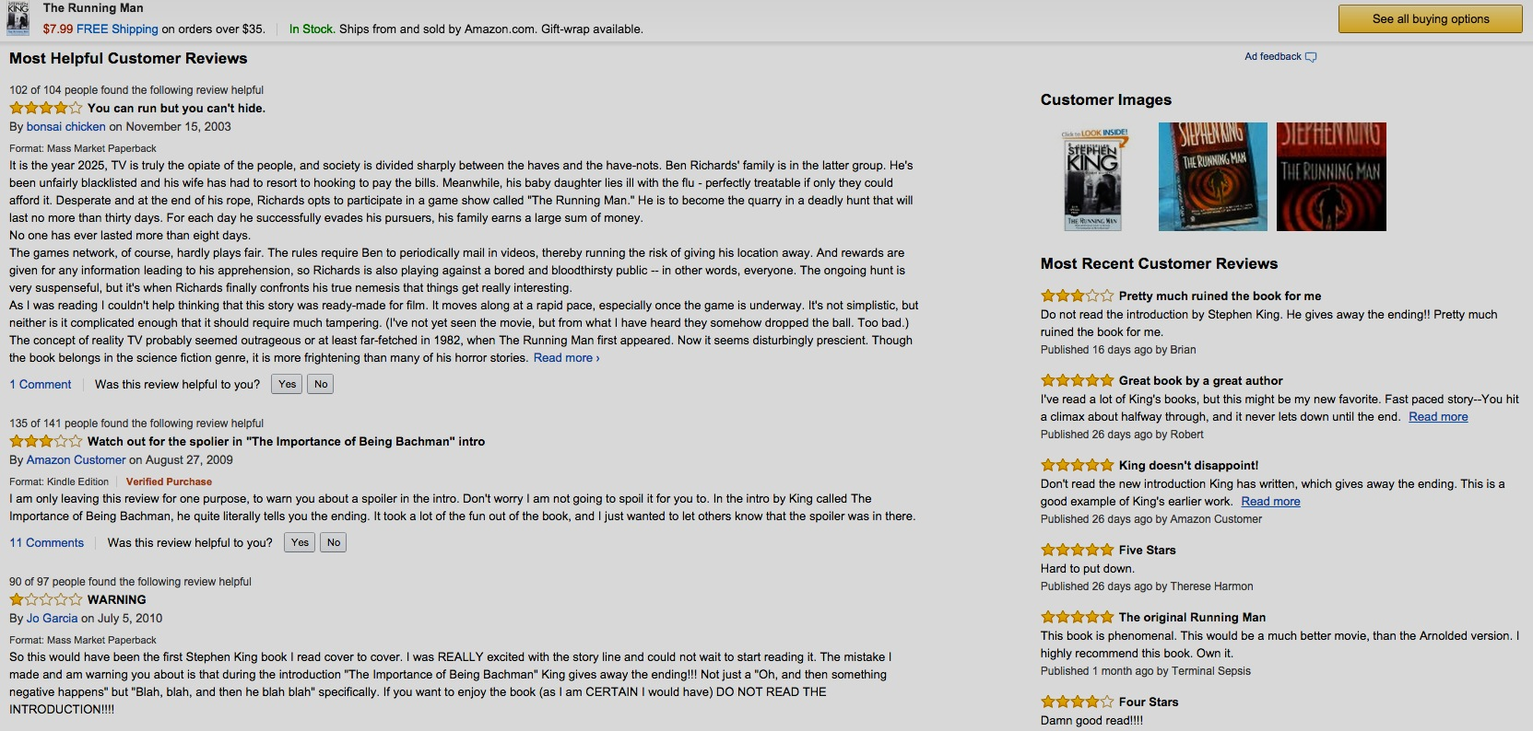
Notes:
http://www.amazon.com/The-Running-Man-Stephen-King/dp/0451197968

Slide 15
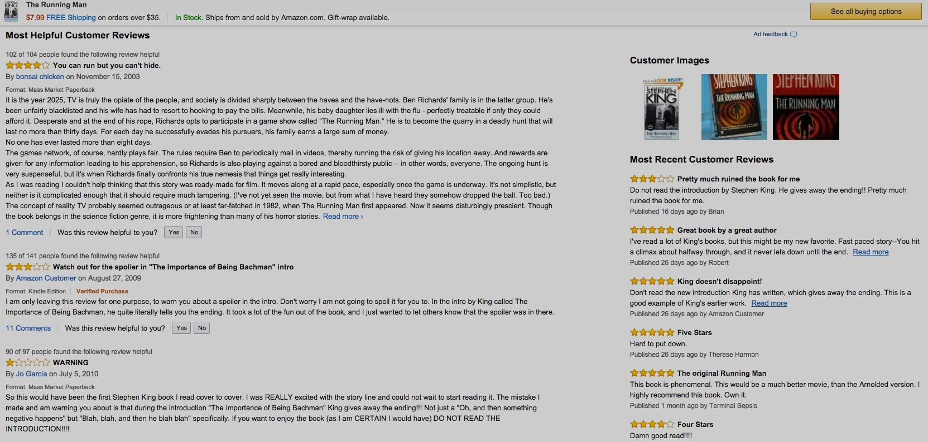
Notes:
http://www.amazon.com/The-Running-Man-Stephen-King/dp/0451197968

Slide 16
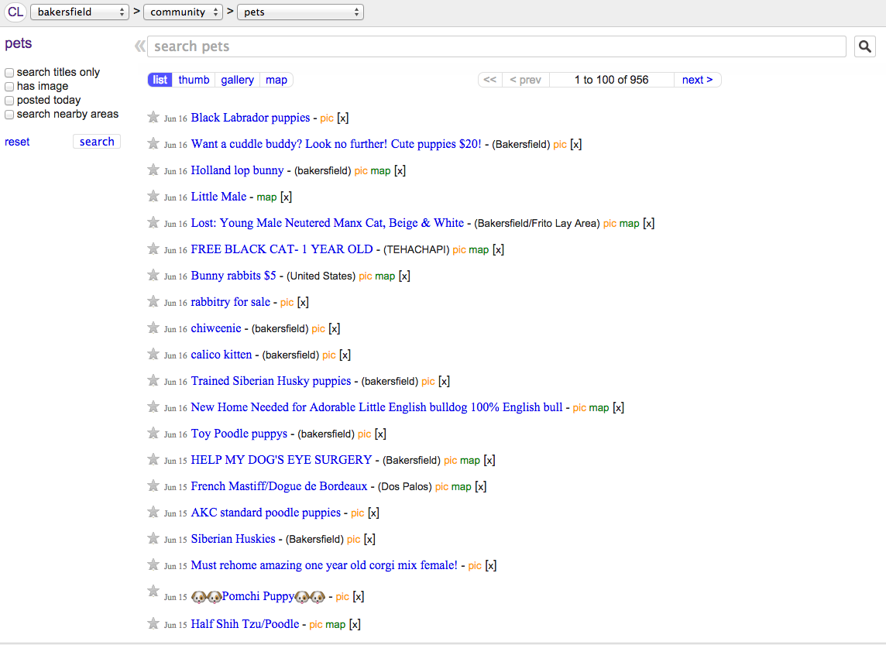
Notes:
http://bakersfield.craigslist.org/search/pet

Slide 17
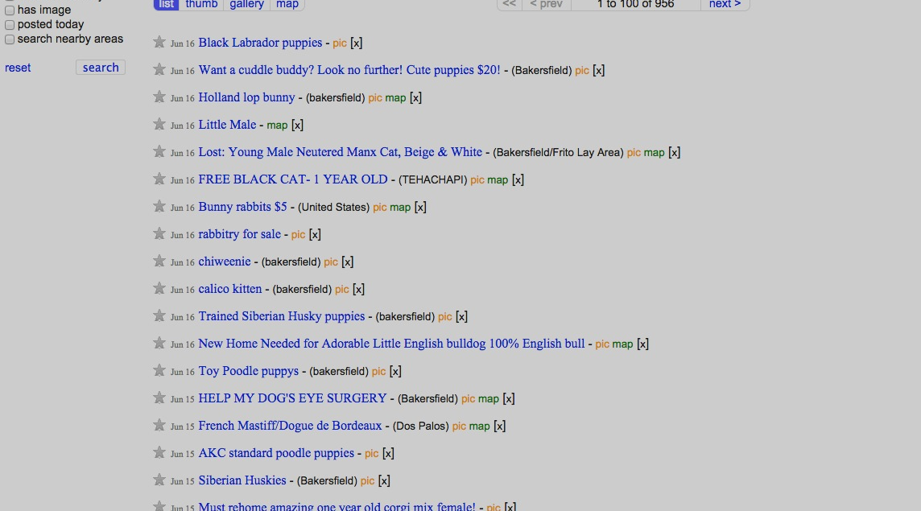
Notes:
http://bakersfield.craigslist.org/search/pet

Slide 18
Notes:
http://bakersfield.craigslist.org/search/pet

Slide 19
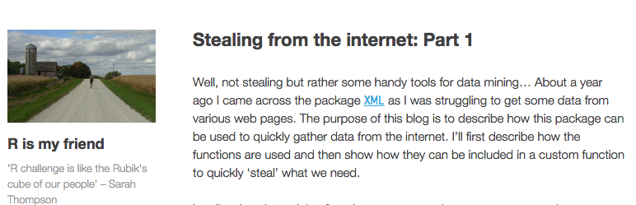
Notes:
https://beckmw.wordpress.com/2012/12/20/stealing-from-the-internet-part-1/

Slide 20
Notes:
https://beckmw.wordpress.com/2012/12/20/stealing-from-the-internet-part-1/

Slide 21
Notes:
https://beckmw.wordpress.com/2012/12/20/stealing-from-the-internet-part-1/

Slide 22
Notes:
https://beckmw.wordpress.com/2012/12/20/stealing-from-the-internet-part-1/

Slide 23
Extraction
HTML source code

Slide 24
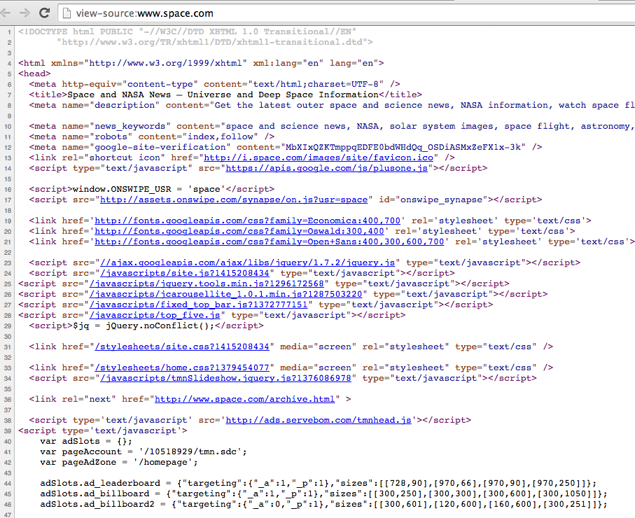
Notes:
view-source:http://www.space.com/

Slide 25
Extraction
HTML source code
Regular Expressions

Slide 26
Extraction
HTML source code
Regular Expressions
[A-Za-z]

Slide 27
Extraction
HTML source code
Regular Expressions
[A-Za-z]
[0-9]

Slide 28
Extraction
HTML source code
Regular Expressions
[A-Za-z]
[0-9]
\s+

Slide 29
Extraction
HTML source code
Regular Expressions
[A-Za-z]
1. ‘pageAccount’,’tmn\.sdc’
[0-9]
\s+

Slide 30
Extraction
HTML source code
Regular Expressions
1. ‘pageAccount’,’tmn\.sdc’
2. ‘[0-9]{8}’

Slide 31
Extraction
HTML source code
Regular Expressions
1. ‘pageAccount’,’tmn\.sdc’
2. ‘[0-9]{8}’
Easily Extracted and Saved

Slide 32
Basic Text Processing (2)
Microsoft Corp and Skype Global today announced that they have entered into a definitive agreement under which Microsoft will acquire Skype, the leading Internet communications company, for $8.5 billion in cash from the investor group led by Silver Lake. The agreement has been approved by the boards of directors of both Microsoft and Skype.
Notes:
Provost, Foster. Data Science For Business: What You Need to Know About Data Mining And Data-Analytical Thinking. Pg.253 19 Aug. 2013. Print.

Slide 33
Basic Text Processing (2)
Stemming/Lemmatizing (remove tenses/other grammar)
Microsoft Corp and Skype Global today announced that they have entered into a definitive agreement under which Microsoft will acquire Skype, the leading Internet communications company, for $8.5 billion in cash from the investor group led by Silver Lake. The agreement has been approved by the boards of directors of both Microsoft and Skype.
Notes:
Provost, Foster. Data Science For Business: What You Need to Know About Data Mining And Data-Analytical Thinking. Pg.253 19 Aug. 2013. Print.

Slide 34
Basic Text Processing (2)
Stemming/Lemmatizing
features

Slide 35
Basic Text Processing (2)
Stemming/Lemmatizing
features
featur
Notes:
Reduce to the base/dictionary form of word (the lemma)

Slide 36
Basic Text Processing (2)
Stemming/Lemmatizing
features biologically
featur biolog

Slide 37
Basic Text Processing (2)
Stemming/Lemmatizing
features biologically saw saw
featur biolog s see/saw
Stemming
Lemmatizing
Notes:
Lemmatizing=morphology of the word (its morpheme, for example)

Slide 38
Basic Text Processing (2)
Stemming/Lemmatizing
features biologically saw saw
featur biolog s see/saw
Porter Algorithm – empirically effective method to stem English words, consists of 5 phases
Stemming
Lemmatizing
Notes:
http://nlp.stanford.edu/IR-book/html/htmledition/stemming-and-lemmatization-1.html

Slide 39
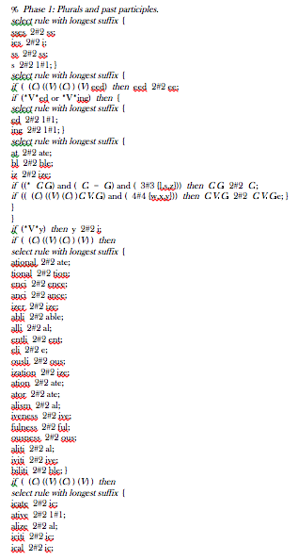
Notes:
http://people.ischool.berkeley.edu/~hearst/irbook/porter.html

Slide 40
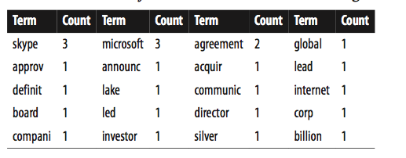
Microsoft Corp and Skype Global today announced that they have entered into a definitive agreement under which Microsoft will acquire Skype, the leading Internet communications company, for $8.5 billion in cash from the investor group led by Silver Lake. The agreement has been approved by the boards of directors of both Microsoft and Skype.
Example and table from Provost and Fawcett’s Data Science For Business
Notes:
Provost, Foster. Data Science For Business: What You Need to Know About Data Mining And Data-Analytical Thinking. Pg.253 19 Aug. 2013. Print.

Slide 41
Modeling

Slide 42

Bag-of-words Model
Most simple model, throws away linguistic structure/word order
“If you must blink, do it now.”
blink
If
it
you
now
must
do
Notes:
https://pixabay.com/p-305400/?no_redirect

Slide 43
Application of Bag-of-Words Model
Similarity – Allows us to represent two objects numerically (using a text representation method) and compare them
Similar wine recommendations
Movie recommendations
Ad recommendations
Most relevant results from search queries

Slide 44
Text Representation Methods
Term Frequency (TF)– How common does a term appear in a document?
TF(t,d) =
Inverse Document Frequency (IDF) – How common does a term appear across documents?
IDF(t) = 1 + log( )
# word t in d_{i}
,Ɐt in d_{i}
Total # of Documents
# Documents with t
,Ɐt
Bigger weight to rarer terms

Slide 45
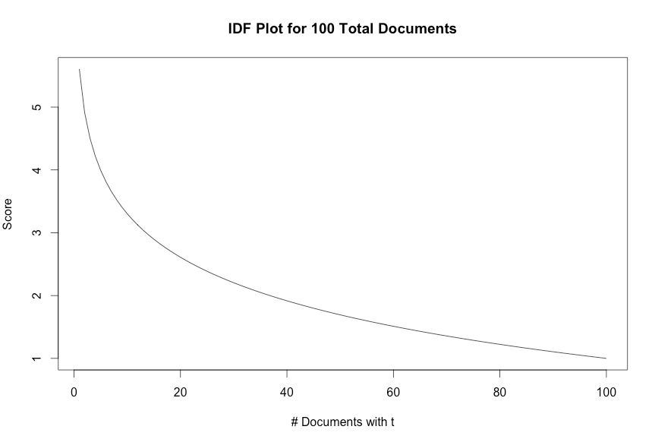
IDF Plot

Slide 46
Text Representation Methods
Term Frequency-Inverse Document Frequency
TFIDF(t,d) = TF(t,d) x IDF(t)
Reminder: Terms are often lemmatized before performing text representation methods

Slide 47
Microsoft Corp and Skype Global today announced that they have entered into a definitive agreement under which Microsoft will acquire Skype, the leading Internet communications company, for $8.5 billion in cash from the investor group led by Silver Lake. The agreement has been approved by the boards of directors of both Microsoft and Skype.
Example and table from Provost and Fawcett’s Data Science For Business
Notes:
Provost, Foster. Data Science For Business: What You Need to Know About Data Mining And Data-Analytical Thinking. Pg.253 19 Aug. 2013. Print.

Slide 48
Measuring Similarity/Distance
Euclidean Distance
Product A
Product B
3
9
1
3
4
7
1
5

Slide 49
Measuring Similarity/Distance
Euclidean Distance
√(3-4)²+(9-7)²+(1-1)²+(3-5)²
Product A
Product B
3
9
1
3
4
7
1
5

Slide 50
Measuring Similarity/Distance
Euclidean Distance
√(3-4)²+(9-7)²+(1-1)²+(3-5)²
Product A
Product B
3
9
1
3
4
7
1
5

Slide 51
Measuring Similarity/Distance
Euclidean Distance
√(3-4)²+(9-7)²+(1-1)²+(3-5)²
Manhattan Distance
Product A
Product B
3
9
1
3
4
7
1
5

Slide 52
Measuring Similarity/Distance
Euclidean Distance
√(3-4)²+(9-7)²+(1-1)²+(3-5)²
Manhattan Distance
(3-4)+(9-7)+(1-1)+(3-5)
Product A
Product B
3
9
1
3
4
7
1
5

Slide 53
Measuring Similarity/Distance
Euclidean Distance
√(3-4)²+(9-7)²+(1-1)²+(3-5)²
Manhattan Distance
(3-4)+(9-7)+(1-1)+(3-5)
Cosine Distance (Most Common For Texts)
Helps limit influence of long vs. short document lengths
Product A
Product B
3
9
1
3
4
7
1
5

Slide 54
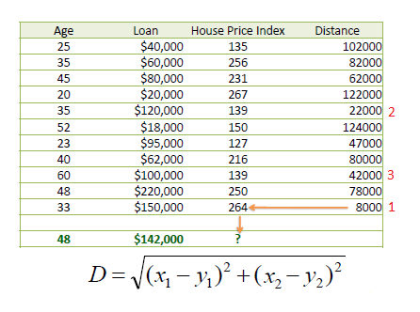
Example with Numerical Data

Slide 55
Example with Numerical Data

Slide 56
Example with Data
Y₁
Y₂
X₁
X₂

Slide 57
Classification
After similarity/distance calculation, can begin classification:
K-Nearest Neighbors
Hierarchical Clustering
K-means Clustering

Slide 58
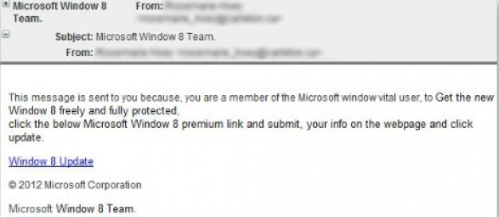
Text Classification
Assignment to a category, group, or topic
Examples:
Spam or Not Spam
Notes:
http://fraudalert.co.za/phishing-email-hijacks-windows-8-launch/

Slide 59
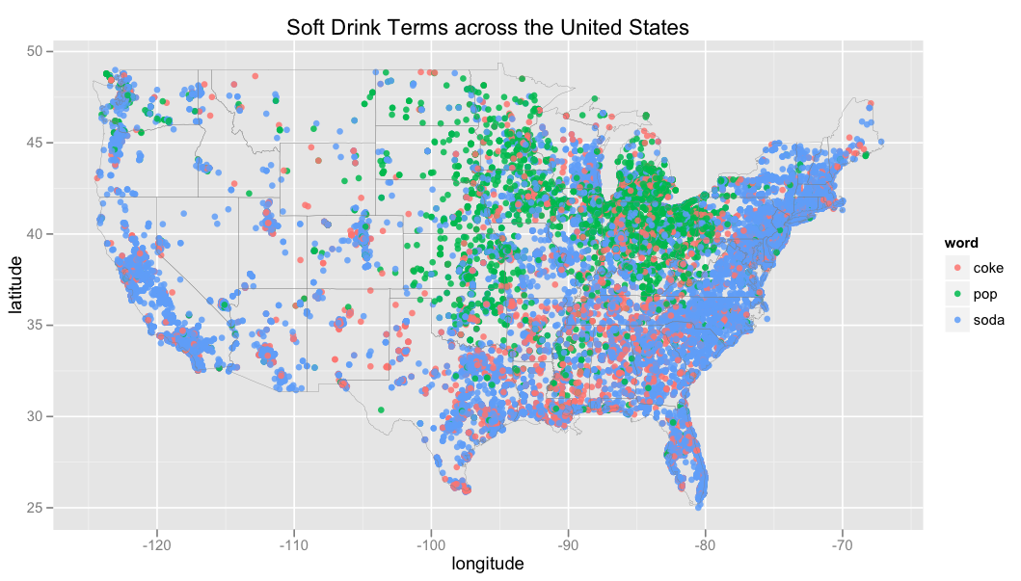
Text Classification
2. Which country region are you from?
Notes:
https://dl.dropboxusercontent.com/u/10506/blog/sodapop/united-states.png

Slide 60
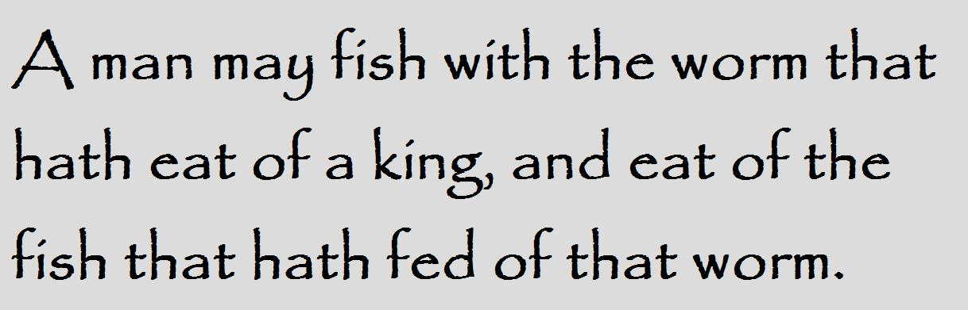
Text Classification
3. Time period of a written work
Notes:
https://bookquoteshub.files.wordpress.com/2013/04/hamlet-5.jpg

Slide 61
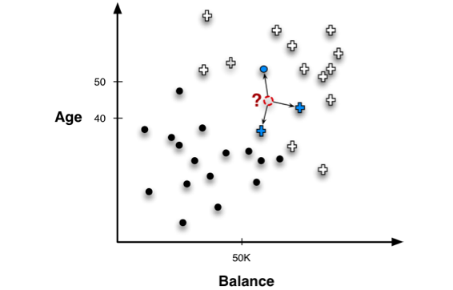
K-Nearest Neighbor
Notes:
Provost, Foster. Data Science For Business: What You Need to Know About Data Mining And Data-Analytical Thinking. Pg.147 19 Aug. 2013. Print.

Slide 62
K-Nearest Neighbor
Realistically, there are many many more variables (dimensionality)
Notes:
Provost, Foster. Data Science For Business: What You Need to Know About Data Mining And Data-Analytical Thinking. Pg.147 19 Aug. 2013. Print.

Slide 63
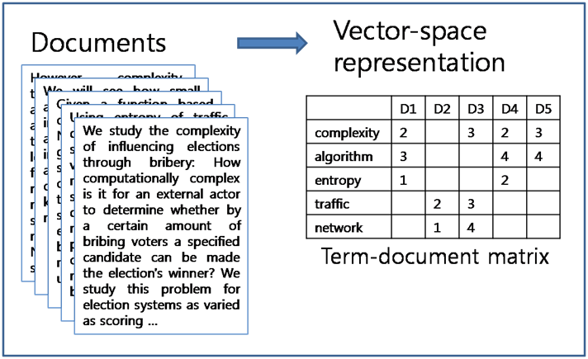
Text Example (High Dimensionality)
Category A B D A
Notes:
http://mlg.postech.ac.kr/static/research/nmf_cluster1.PNG

Slide 64
Text Example (High Dimensionality)
Category A B D A
Notes:
http://mlg.postech.ac.kr/static/research/nmf_cluster1.PNG

Slide 65
Text Example (High Dimensionality)
Similarity?
Category A B D A ?
Notes:
http://mlg.postech.ac.kr/static/research/nmf_cluster1.PNG

Slide 66
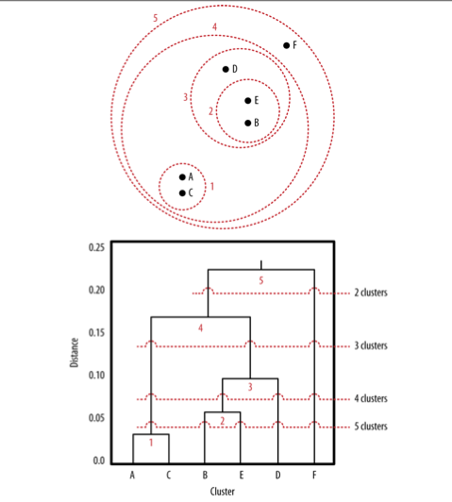
Hierarchical Clustering
Notes:
Provost, Foster. Data Science For Business: What You Need to Know About Data Mining And Data-Analytical Thinking. Pg.165 19 Aug. 2013. Print.

Slide 67
Hierarchical Clustering
Compute similarities
between each pair of points
Notes:
Provost, Foster. Data Science For Business: What You Need to Know About Data Mining And Data-Analytical Thinking. Pg.165 19 Aug. 2013. Print.

Slide 68
Hierarchical Clustering
Compute similarities
between each pair of points
Group most similar points together into a cluster
Notes:
Provost, Foster. Data Science For Business: What You Need to Know About Data Mining And Data-Analytical Thinking. Pg.165 19 Aug. 2013. Print.

Slide 69
Hierarchical Clustering
Compute similarities
between each pair of points
Group most similar points together into a cluster
Compute similarities
between each pair of
points or cluster
Notes:
Provost, Foster. Data Science For Business: What You Need to Know About Data Mining And Data-Analytical Thinking. Pg.165 19 Aug. 2013. Print.

Slide 70
Hierarchical Clustering
Compute similarities
between each pair of points
Group most similar points together into a cluster
Compute similarities
between each pair of
points or cluster
Group and Repeat…
Notes:
Provost, Foster. Data Science For Business: What You Need to Know About Data Mining And Data-Analytical Thinking. Pg.165 19 Aug. 2013. Print.

Slide 71
Hierarchical Clustering
Compute similarities
between each pair of points
Group most similar points together into a cluster
Computationally
Slow
Compute similarities
between each pair of
points or cluster
Group and Repeat…
Notes:
Provost, Foster. Data Science For Business: What You Need to Know About Data Mining And Data-Analytical Thinking. Pg.165 19 Aug. 2013. Print.

Slide 72
K-Means Clustering
Find the “centers” of each cluster

Slide 73
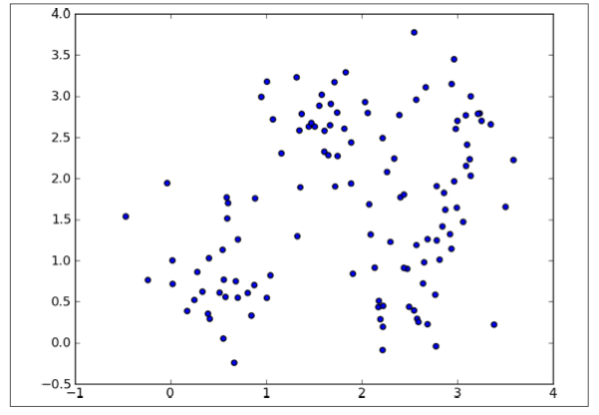
K-Means Clustering
Find the “centers” of each cluster
Notes:
Provost, Foster. Data Science For Business: What You Need to Know About Data Mining And Data-Analytical Thinking. Pg.172 19 Aug. 2013. Print.

Slide 74
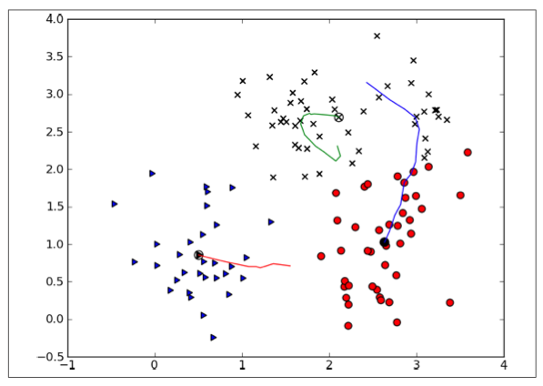
K-Means Clustering
Find the “centers” of each cluster
Notes:
Provost, Foster. Data Science For Business: What You Need to Know About Data Mining And Data-Analytical Thinking. Pg.172-173 19 Aug. 2013. Print.

Slide 75
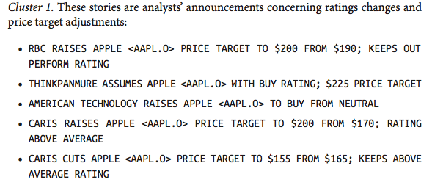
K-Means Example Results
Notes:
Provost, Foster. Data Science For Business: What You Need to Know About Data Mining And Data-Analytical Thinking. Pg.175 19 Aug. 2013. Print.

Slide 76
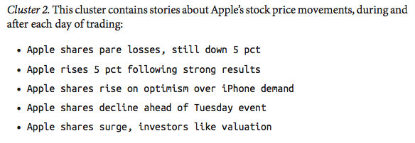
K-Means Example Results
Notes:
Provost, Foster. Data Science For Business: What You Need to Know About Data Mining And Data-Analytical Thinking. Pg.175 19 Aug. 2013. Print.

Slide 77
Quick Summary
Extraction => Stemming => Text Valuation/Representation
HTML Porter’s Algorithm TF IDF TFIDF
=> Similarity/Distance Calculation => Text Classification
Euclidean
Manhattan
Cosine
KNN
Hierarchical Clustering
K-Means

Slide 78
Other Models

Slide 79
Probabilistic Language Modeling
Goal: To assign a probability to how likely a sentence or phrase occurs

Slide 80
Probabilistic Language Modeling
Goal: To assign a probability to how likely a sentence or phrase occurs
Examples/Applications:
“El doctor recommendó une exploración del gato.”

Slide 81
Probabilistic Language Modeling
Goal: To assign a probability to how likely a sentence or phrase occurs
Examples/Applications:
“El doctor recommendó une exploración del gato.”
P(the doctor recommends a cat scan) >
P(the doctor recommends a scan of the cat)

Slide 82
Probabilistic Language Modeling
Goal: To assign a probability to how likely a sentence or phrase occurs
Examples/Applications:
“El doctor recommendó une exploración del gato.”
P(the doctor recommends a cat scan) >
P(the doctor recommends a scan of the cat)
Machine
Translation

Slide 83
Probabilistic Language Modeling
Goal: To assign a probability to how likely a sentence or phrase occurs
Examples/Applications:
“El doctor recommendó une exploración del gato.”
P(the doctor recommends a cat scan) >
P(the doctor recommends a scan of the cat)
P(give me a minute) > P(give me a minuet)
Machine
Translation
Spell
Checking

Slide 84
Calculating Probability of a Phrase
P(the quick brown fox jumps over the lazy dog) =

Slide 85
Calculating Probability of a Phrase
P(the quick brown fox jumps over the lazy dog) =
P(ABCDEFGHI) =
Chain Rule
P(A)*P(B|A)*P(C|AB)*P(D|ABC)*P(E|ABCD)*…

Slide 86
Calculating Probability of a Phrase
P(the quick brown fox jumps over the lazy dog) =
P(ABCDEFGHI) =
Chain Rule
P(A)*P(B|A)*P(C|AB)*P(D|ABC)*P(E|ABCD)*…
So we have => P(the)*P(quick|the)*P(brown|the quick)*…
P(dog|the quick brown fox jumps over the lazy) = ?

Slide 87
Estimating Probabilities
P( over|the quick brown fox jumps ) =
# Times We See “the quick brown fox jumps over”
# Times We See “the quick brown fox jumps”

Slide 88
Estimating Probabilities
P( over|the quick brown fox jumps ) =
# Times We See “the quick brown fox jumps over”
# Times We See “the quick brown fox jumps”
almost never a large
enough corpus to
reasonably estimate this
Might need a another solution:

Slide 89
Markov Assumption for Simplification
To simplify the previous conditional probability:
P(dog|the quick brown fox jumps over the lazy) ≈
P(dog) – Unigram Model
P(dog|lazy) – Bi-gram Model
P(dog|the lazy) – Tri-gram Model
P(dog|over the lazy) – 4-grams Model
…

Slide 90
Markov Assumption for Simplification
To simplify the previous conditional probability:
P(dog|the quick brown fox jumps over the lazy) ≈
P(dog) – Unigram Model
P(dog|lazy) – Bi-gram Model
P(dog|the lazy) – Tri-gram Model
P(dog|over the lazy) – 4-grams Model
…
N-Gram Models

Slide 91
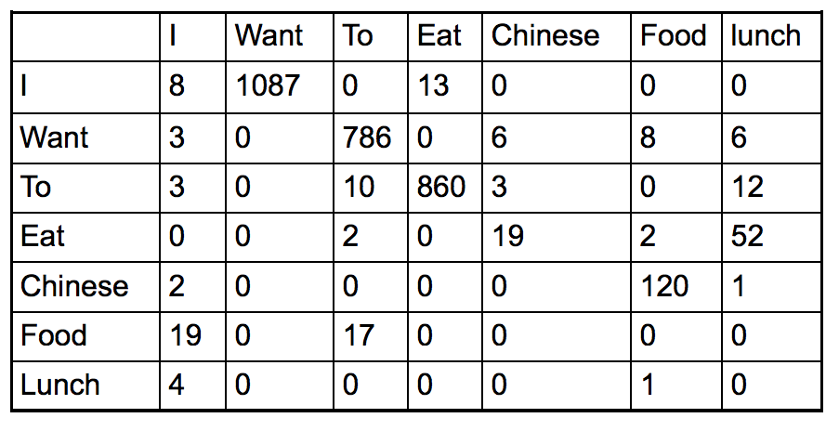
Bigram Table from BERP
Notes:
http://www.cs.columbia.edu/~kathy/NLP/ClassSlides/Class3-ngrams09/ngrams.pdf

Slide 92
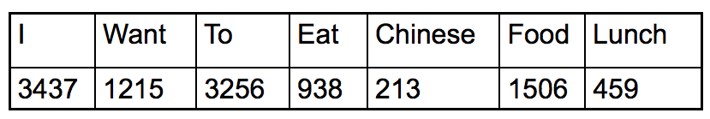
Bigram Table from BERP
Normalize (Divide by Row Count) Each Bigram with Total Count of Each Word
Notes:
http://www.cs.columbia.edu/~kathy/NLP/ClassSlides/Class3-ngrams09/ngrams.pdf

Slide 93
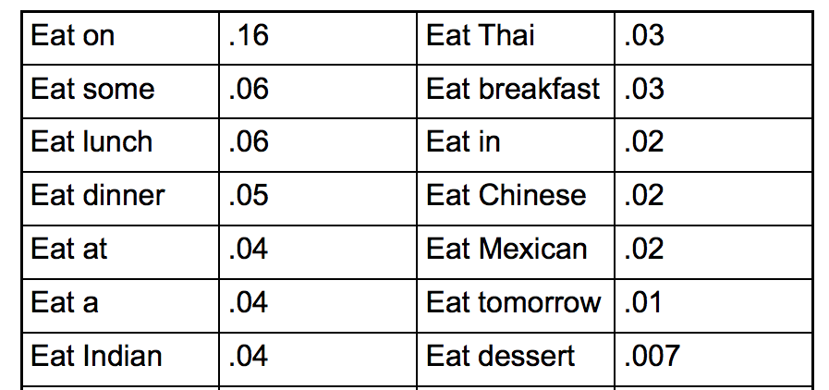
Bigram Table from BERP
Notes:
http://www.cs.columbia.edu/~kathy/NLP/ClassSlides/Class3-ngrams09/ngrams.pdf

Slide 94
Meaning?
Notes:
http://www.cs.columbia.edu/~kathy/NLP/ClassSlides/Class3-ngrams09/ngrams.pdf

Slide 95
Meaning?
Example:
The phrase: “I want British food.”
is less likely than:
“I want Chinese food.”
(Marketing implications)
Notes:
http://www.cs.columbia.edu/~kathy/NLP/ClassSlides/Class3-ngrams09/ngrams.pdf

Slide 96
Named Entity Extraction/Recognition

Slide 97
Named Entity Extraction/Recognition
Pinpointing proper nouns/distinctive names

Slide 98
Named Entity Extraction/Recognition
Pinpointing proper nouns/distinctive names
The Challenge:
“The Warriors won…”

Slide 99

Named Entity Extraction/Recognition
Pinpointing proper nouns/distinctive names
The Challenge:
“The Warriors won…”
The Basketball Team

Slide 100

Named Entity Extraction/Recognition
Pinpointing proper nouns/distinctive names
The Challenge:
“The Warriors won…”
The Basketball Team
A Brave Soldier/Fighter

Slide 101
Named Entity Extraction/Recognition
Pinpointing proper nouns/distinctive names
The Challenge:
“The Warriors won…”
The Basketball Team
A Brave Soldier/Fighter
Knowledge and Context
Intensive

Slide 102
NER Classification
Can classify proper nouns even further:
Person
Organization
Location
Date
Product

Slide 103
NER Classification
Can classify proper nouns even further:
Person
Organization
Location
Date
Product
Microsoft Corp and Skype Global today announced that they have entered into a definitive agreement under which Microsoft will acquire Skype, the leading Internet communications company, for $8.5 billion in cash from the investor group led by Silver Lake. The agreement has been approved by the boards of directors of both Microsoft and Skype.

Slide 104
NER Classification
Can classify proper nouns even further:
Person
Organization
Location
Date
Product
Microsoft Corp and Skype Global today announced that they have entered into a definitive agreement under which Microsoft will acquire Skype, the leading Internet communications company, for $8.5 billion in cash from the investor group led by Silver Lake. The agreement has been approved by the boards of directors of both Microsoft and Skype.
“Fitbit is ‘highly dependent on the contributions of our co-founders, James Park and Eric N. Friedman’, as well as other management team members. The company has employment offer letters with its main personnel, but they are not contractually locked in, and can opt to leave at will.
Beyond that, it is located in San Francisco where the competition to find skilled workers is tough, posing a risk to its business. In fact, FitBit admits it has had trouble “attracting and retaining” these highly skilled workers in the past.”
Notes:
Provost, Foster. Data Science For Business: What You Need to Know About Data Mining And Data-Analytical Thinking. Pg.253 19 Aug. 2013. Print.
http://www.marketwatch.com/story/five-things-to-know-about-fitbit-before-its-ipo-2015-05-08

Slide 105

NER Classification Uses

Slide 106

NER Classification Uses

Slide 107

NER Classification Uses

Slide 108
NER Classification Uses
Automatic links to bio pages or stock ticker info pages.

Slide 109
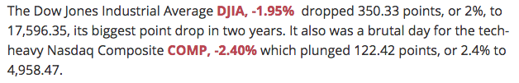
NER Classification Uses
Automatic links to bio pages or stock ticker info pages.
Notes:
http://www.marketwatch.com/story/us-stocks-set-for-sharp-losses-with-greece-on-brink-of-default-2015-06-29

Slide 110
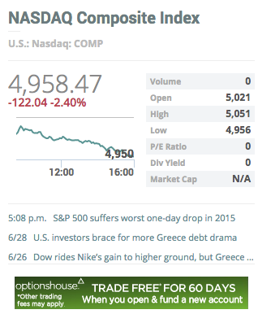
NER Classification Uses
Automatic links to bio pages or stock ticker info pages.
Notes:
http://www.marketwatch.com/story/us-stocks-set-for-sharp-losses-with-greece-on-brink-of-default-2015-06-29

Slide 111
Topics
Quick Terminology
Text Extraction/Stemming
Bag-of-words Model
Text Valuation/Text Representation
Similarity
Text Classification
Other Models: Probabilistic Models
Named Entity Recognition
Fundamental/
Basic Topics

